Slide 1


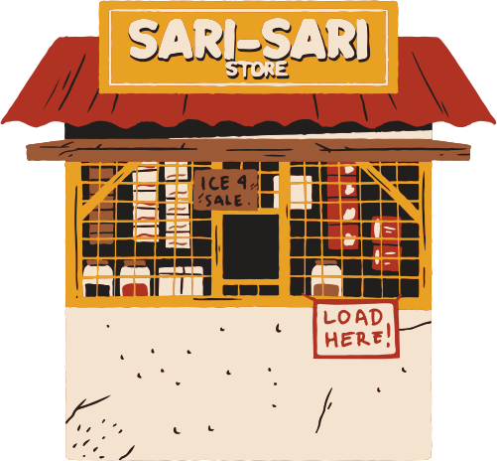





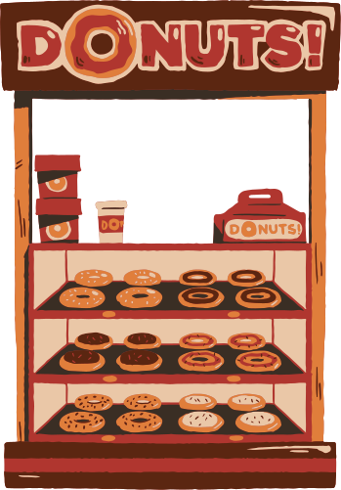

T.I.P.
Tracker for Inventory and Profit
Bisuela, Jason John
Ollaban, Isabela Cristie
Dela Cruz, Benedict John
Olmedo, Kyle Dominic

Slide 2
Introduction

Slide 3

In today’s business climate, efficient profit and loss management and inventory management are crucial for the sustainability of a business.
.

Slide 4
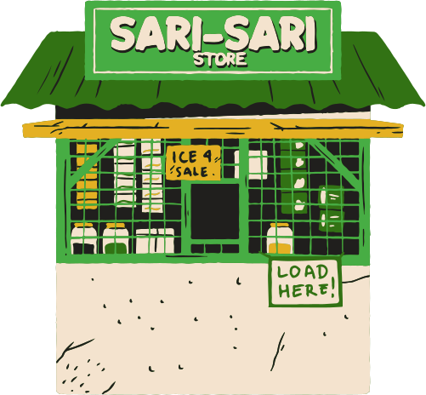
From the study regarding accounting practices on sari-sari stores, published in October 2018,
the majority of the respondents favored manual methods to bookkeep over computerized ones because:
Low Cost
Ease of Use
.

Slide 5
Some business owners track the inventory of their products through mental footnotes and paper which could be susceptible to error and could lead to a situation where the product is unavailable when it is in demand, among other problems that arise with poor product tracking.
This will lead the owners to make poor decisions for their business.
.

Slide 6
Problem
statement

Slide 7

Problem
statement
Some small business owners could have difficulty tracking the inventory of their products since they could use more sophisticated methods which could be prone to error such as writing it in paper or mental footnotes.

Slide 8
Problem
statement
They also could have a difficulty in checking if their products are making a profit since they may use calculations or in some cases, they won’t check for profits and feel if they’re making a profit.

Slide 9
Problem
statement
There is a need for a system that could track inventory of items and check for the total revenue, cost, and profit gained from the products to check if the store is making profit or bleeding money.

Slide 10

Solution

Slide 11
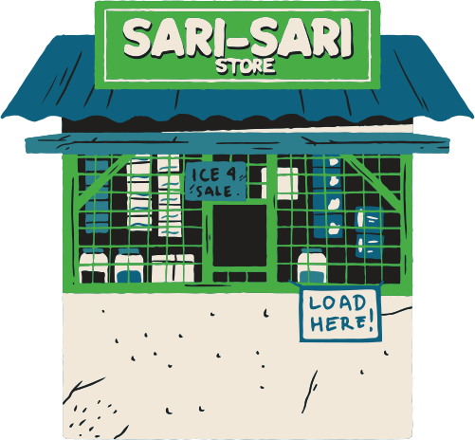
solution
TIP is a program that makes bookkeeping software friendly to sole proprietors that want to start a business with a sari-sari store.

Slide 12

solution
The goal of this project is to simplify the calculation process of net profit/loss for the sole proprietor and help track the current inventory of the products being sold in a sari-sari store.

Slide 13

solution
The calculations of profit/loss can be done erroneously, especially if not done properly, hence this program, alongside its goals to store and track inventory, help keep the numerical data reflective of the store’s current financial position.
As for the inventory, a periodic inventory system will be observed for uniformity.

Slide 14
sdg 8: sustainable economic growth
Since TIP aims to help micro and small enterprises in bookkeeping, it helps with the 8th Sustainable development goal of United Nations. By easing the work of these micro and small enterprises, their economic impact can be positively affected.

Slide 15

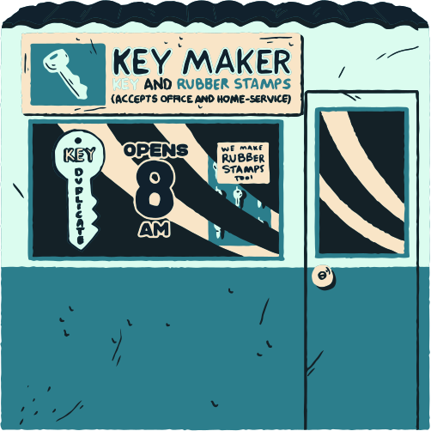
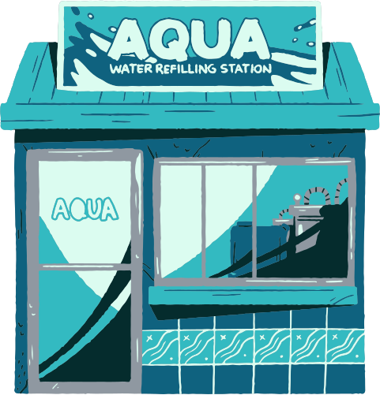
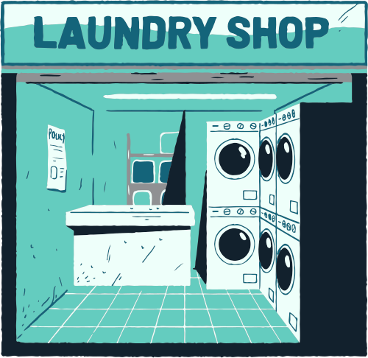
project tip: live code demo

Slide 16




thank you
for listening

